Slide 1

iRec: Your Ultimate Movie Recommendation System
Discover a whole new way to find movies you will love with iRec. This smart recommendation system uses advanced algorithms to curate personalized movie suggestions tailored to your unique tastes, making movie night effortless and enjoyable.

Slide 2

Why iRec? The Core Objectives
Personalized Suggestions
Diverse Movie Choices
iRec analyzes your viewing habits and preferences to recommend movies you're most likely to enjoy.
From blockbusters to indie gems, iRec covers every genre, era, and style.
Easy Discovery
Skip the endless searching and quickly find your next favorite film.

Slide 3
How iRec Works: Behind the Scenes
Data Analysis
Advanced Algorithms
Continuous Learning
iRec collects data on films you rate, watch, and browse to understand your preferences.
Using collaborative filtering and KNN, iRec predicts movies that match your taste profile.
The system evolves as you watch more movies, improving its recommendations over time.

Slide 4
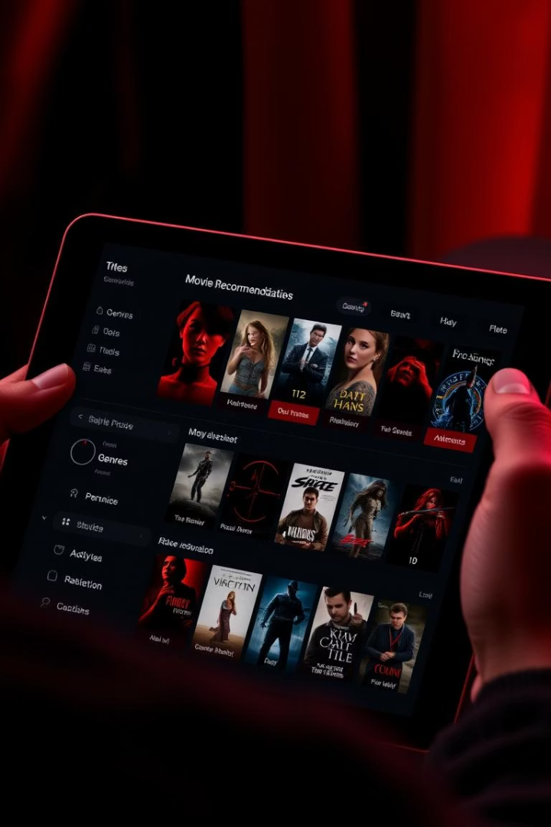
Personalized Features That Set iRec Apart
Mood-Based Selections
Genre Filters
Fine-tune your options by selecting favorite genres or exploring new ones.
Tell iRec how you feel, and it matches movies to your current mood instantly.
Watchlist Management
Easily save recommended movies to watch later or share with friends.

Slide 5









Diverse Movie Catalog
Action
Drama
Adrenaline-pumping thrillers full of excitement and adventure.
Moving stories that pull at the heartstrings and inspire thought.
Thriller
Comedy
Keep on the edge of your seat with suspenseful and captivating plots.
Light-hearted laughs and feel-good moments to brighten your day.

Slide 6





User Experience: Intuitive and Engaging
Search
Quickly explore your favorite titles or discover new ones.
Like
Provide feedback to customize your movie profile and improve suggestions.
Save
Create watchlists to organize movies you don’t want to miss.
Recommend
Recommend favorites to friends and compare tastes.

Slide 7
Performance and Technology
Fast Processing
Easily Developed
Privacy-Focused
iRec delivers instant recommendations with high-speed data processing.
Created from scratch without using any libraries.
Secure handling of user data with strict privacy controls and encryption.

Slide 8

Customer Feedback and Success Stories
Easy to Use
Highly Accurate
Users love the simple interface that makes movie discovery fun and effortless.
Many report finding unexpected favorites thanks to precise recommendations.
Community Engagement
Sharing features have helped build a loyal and interactive user base.

Slide 9
Future Enhancements for iRec
AI-Driven Voice Interaction
1
Talk to iRec to find movies using natural language commands for hands-free exploration.
Virtual Reality Previews
2
Experience immersive trailers and movie snippets in VR before watching.
Social Watch Parties
3
Watch movies simultaneously with friends remotely and chat live.

Slide 10

Get Started with iRec Today!
Start exploring a world of movies tailored just for you with iRec. Whether you crave gripping dramas, hilarious comedies, or thrilling adventures, iRec is your ticket to unforgettable movie experiences.
Download today and make every movie night one to remember. Your perfect film is just a tap away!

